Slide 1
Introduction
to
Amazon Machine Images (AMIs)
Key components and its types
Department of Computer Science and Engineering
Chitkara University, Punjab

Slide 2
What is an AMI?
An Amazon Machine Image (AMI) is a master image that contains all the information needed to launch an Amazon EC2 instance. • Acts like a server blueprint in the cloud. • Contains OS, application server, pre-installed applications & configurations. • Enables quick, consistent deployments.
Example: Create one AMI and launch 10 identical web servers from it.

Slide 3
Why AMIs are Important
• Consistency: Every instance launched from the same AMI has the same configuration.
• Speed: Rapid deployment without manual setup.
• Scalability: Supports auto-scaling for traffic spikes.
• Backup: Serves as a snapshot for disaster recovery.

Slide 4
Key Components
Root Volume Template: OS, app server, configurations.
Launch Permissions: Who can use the AMI.
Block Device Mapping: Defines additional storage volumes.

Slide 5
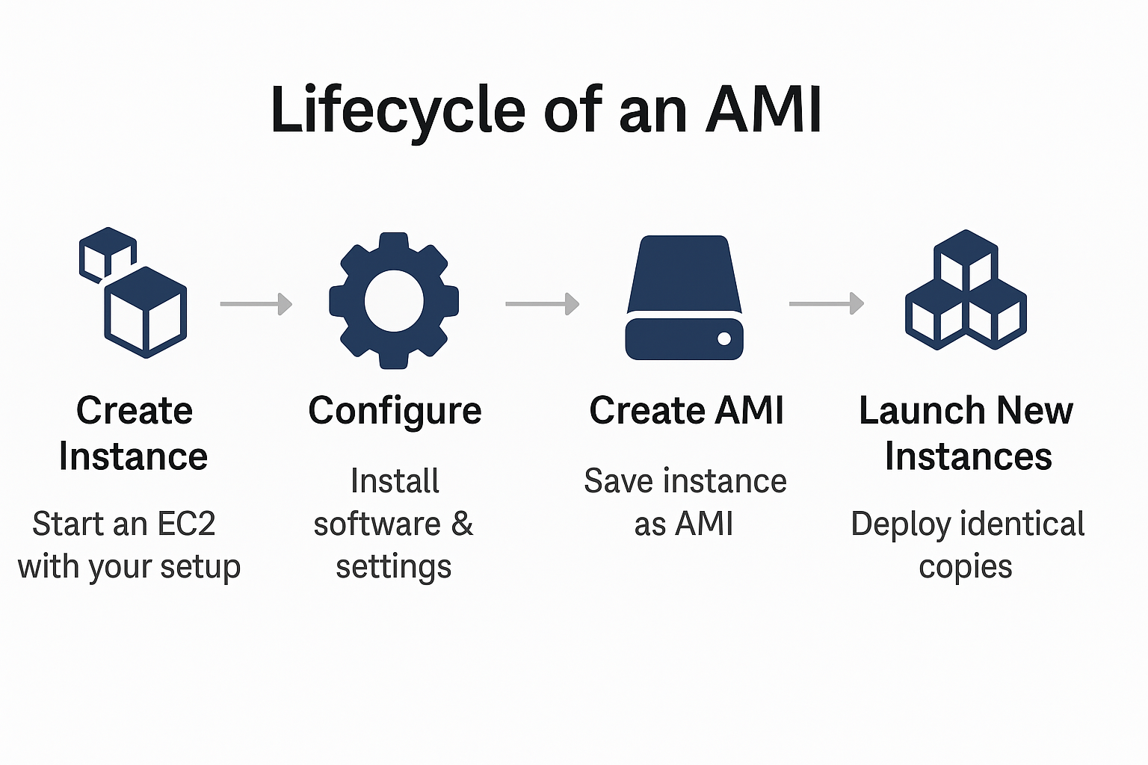
AMI Lifecycle
Create Instance – Start an EC2 with your setup.
Configure – Install software & settings.
Create AMI – Save instance as AMI.
Launch New Instances – Deploy identical copies.

Slide 6
Types of AMIs
Based on Source and Ownership
a. AWS-Provided AMIs
Created and maintained by AWS.
Examples: Amazon Linux, Ubuntu, Windows Server official images.
Regularly updated and patched by AWS.
b. Marketplace AMIs
Offered by third-party vendors via the AWS Marketplace.
May include pre-installed software (e.g., WordPress, SAP, security tools).
Can be free or paid, depending on the vendor.
c. Community AMIs
Shared publicly by AWS users.
Free to use but not officially supported; you must verify security and configuration yourself.

Slide 7
d. Private/Custom AMIs
Created by you (or your organization) for internal use.
Based on an existing instance that you configure with your own software, settings, and data.
2. Based on Virtualization Type
a. Hardware Virtual Machine (HVM) AMIs: Fully virtualized hardware, Supports enhanced networking, GPU instances, and modern instance types and Recommended for most workloads today.
b. Paravirtual (PV) AMIs (Legacy): Older virtualization method and No longer recommended for new deployments because HVM offers better performance.

Slide 8
3. Based on Billing Model
Free AMIs
No additional charge apart from EC2 usage.
Includes AWS free tier OS images like Amazon Linux and Ubuntu.
Paid AMIs
Extra hourly or monthly license fee on top of EC2 costs.
Common for enterprise software (e.g., Microsoft SQL Server, Red Hat).

Slide 9
Comparison table
Type | Source | Cost | Support | Pros | Cons | Best Use Cases
AWS-Provided AMI | Official AWS | Free (EC2 usage only) | Fully supported & regularly updated by AWS | Secure, reliable, always up-to-date | Limited customization out-of-the-box | Standard Linux/Windows servers, quick deployments
Marketplace AMI | AWS Marketplace Vendors | Free or Paid (license fee + EC2 cost) | Vendor-provided | Pre-installed software, ready-to-use enterprise apps | Paid versions can be expensive | Commercial apps, enterprise solutions (e.g., SAP, security tools)
Community AMI | Shared by AWS users | Free | No official support | Large variety, may fit niche needs | Security risks, outdated images | Experimentation, non-production testing
Private/Custom AMI | Created by you/organization | Free (EC2 usage only) | Self-supported | Fully customized, reusable, secure for your needs | You maintain updates & patches | Production environments, cloning specific setups

Slide 10
Type | Source | Cost | Support | Pros | Cons | Best Use Cases
HVM AMI (Virtualization) | Any | Free (EC2 usage only) | Self-supported | Modern, high performance, supports enhanced networking & GPUs | None significant | Most workloads, especially new ones
PV AMI (Legacy Virtualization) | Any | Free (EC2 usage only) | Self-supported | Works with older instance types | Lower performance, outdated | Legacy migrations only

Slide 11
Benefits of Using AMIs
Rapid Deployment: Launch fully configured instances in minutes instead of hours.
Consistency: Every instance has identical configuration, reducing variability and bugs.
Scalability: Easily integrate with Auto Scaling Groups to handle demand surges automatically.
Disaster Recovery: Quickly restore systems by launching from backup AMIs in case of failures.

Slide 12
Multi-Region Availability: Copy AMIs across AWS regions to support global application deployment.
Cost Efficiency: Minimizes setup time and administrative effort, lowering operational costs.
Testing & Development: Create multiple isolated test environments from the same base image without affecting production.
Version Control – Maintain different AMI versions for various project stages, making rollbacks or upgrades easier.

Slide 13
THANK YOU
Cloud Computing

